Slide 1

RIGHT ACCORD Health staffing & placement services, llc
INTERNATIONAL NURSING RECRUITMENT
www.rightaccordhealthstaffing.com

Slide 2




ABOUT US:
Rosemary Kaminski, RN BA
Administrator
Rosemarie Tamunday-Casanova, RN,MHA
CEO/Owner
Raymart Lu, BS Business Administration
Business Development Specialist

Slide 3
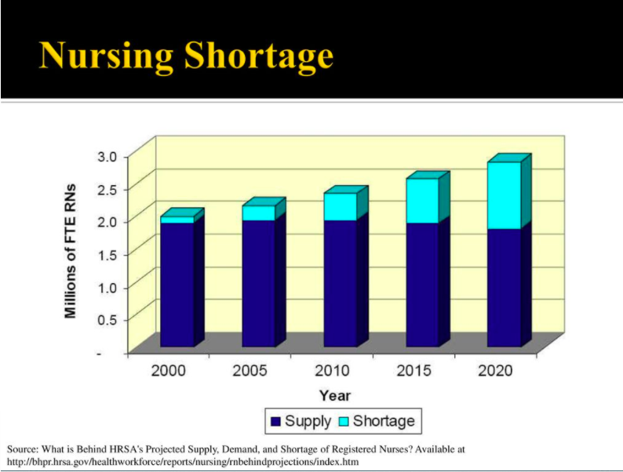
THE U.S. NURSING SHORTAGE

Slide 4
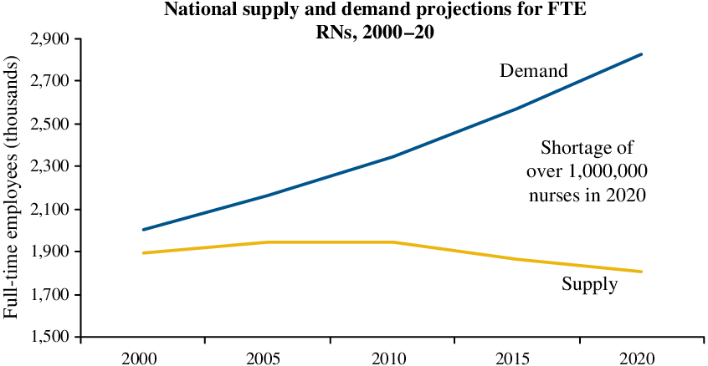
NURSE SUPPLY AND DEMAND

Slide 5
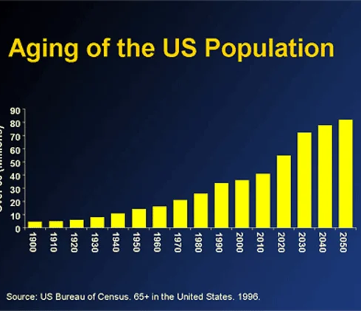
HEALTH CARE INDUSTRY AND

Slide 6

Why International Nursing Recruitment ?

Slide 7
Foreign Nurses in most cases are:
Caring and Compassionate
Disciplined and posses good work ethics
Has excellent nursing skills and knowledge
Has good sense of humor and positive outlook
Team Player and flexible

Slide 8
Benefits of INR to HCO
Improved Patient Satisfaction
Increased Employee Morale
Better Quality Care Outcomes
Reduced Nurse Staff Turn-Over
Reduce Cost of Hire
Higher Compliance Rating

Slide 9
Is your HCO experiencing?
Short staffing? Or Nurses retiring?
Lower staff satisfaction and morale?
Poor quality of care secondary to increase patient : nurse ratio?
Increasing hospital readmissions?
Using temporary staffing or traveling nurses to fill the gaps?

Slide 10

3 STEP PROCESS
NCLEX – RN LICENSE
VISA – SPONSORSHIP
ARRIVAL – ADAPTATION / ORIENTATION

Slide 11
U.S. RN LICENSING REQUIREMENTS
CGFNS
TOEFL OR IELTS
CES – Credential Evaluation Services
Clinical Experience
Criminal Background Checks
NCLEX
Continuing Education

Slide 12
GREEN CARD VISA REQUIREMENTS
NCLEX
VISA SCREEN
U.S. LABOR WAGE DETERMINATION
JOB POSTING
1-40
ADJUSTMENT OF STATUS

Slide 13
TIMELINE TO VISA ISSUANCE
NCLEX – 6-8 MONTHS
LABOR DEPARTMENT – WAGE DETERMINATION
1-40 – 6 MONTHS
Adjustment of Status – Approx 6 MONTHS
Premium Processing – 15 Days

Slide 14
EMPLOYER - VISA FILING REQUIRMENTS
FACILITY/HOSPITAL DOCUMENTS
FINANCIAL DOCUMENTS
TAX RETURNS
AUDITED FINANCIALS
PROOF OF THE ABILITY TO PAY THE NURSES

Slide 15
FEES TO OBTAIN RN LICENSE
CGFNS - $475 – RETEST- $250 – VERIFICATION - $100
CES – Credential Evaluation Services – 350
NCLEX Application – within U.S. $350 – Outside $500
NCLEX REVIEW - $250-$500
TOEFL - $235 IELTS - $235
IPASS Processing – 3rd Party $850 - $1250
Estimated Total - $3000

Slide 16
COST OF VISA PROCESSING
VISA SCREEN - $850
ATTORNEY FEES - $4500
JOB POSTING - $500
VISA FILING FEE - $700/+ per family member $750
ADJUSTMENT OF STATUS - $1225 – PER FAMILY $750
PREMIUM PROCESSING - $2500
ESTIMATED TOTAL - $8000
GREEN CARD ISSUANCE - $225
MEDICAL CLEARANCE –$ per origin

Slide 17
ARRIVAL EXPENSES
AIRFARE - $1000
HOUSING ALLOWANCE – 1ST 2 MONTHS $2000
TRANSPORATION AND FOOD ALLOWANCE - $1000
POCKET MONEY - $1000 (Suggested until first paycheck)
Estimated Total: - $5000

Slide 18
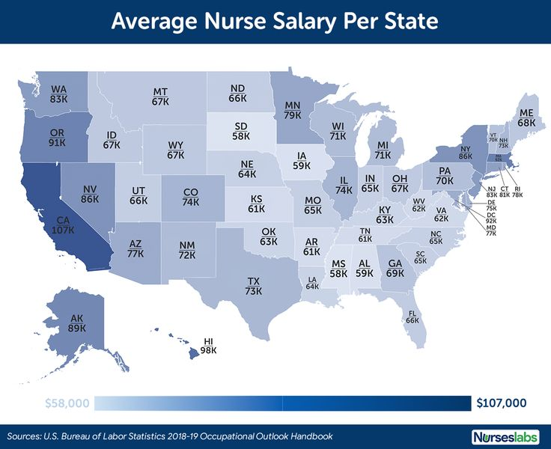
WAGE COMPARISON BY STATE

Slide 19
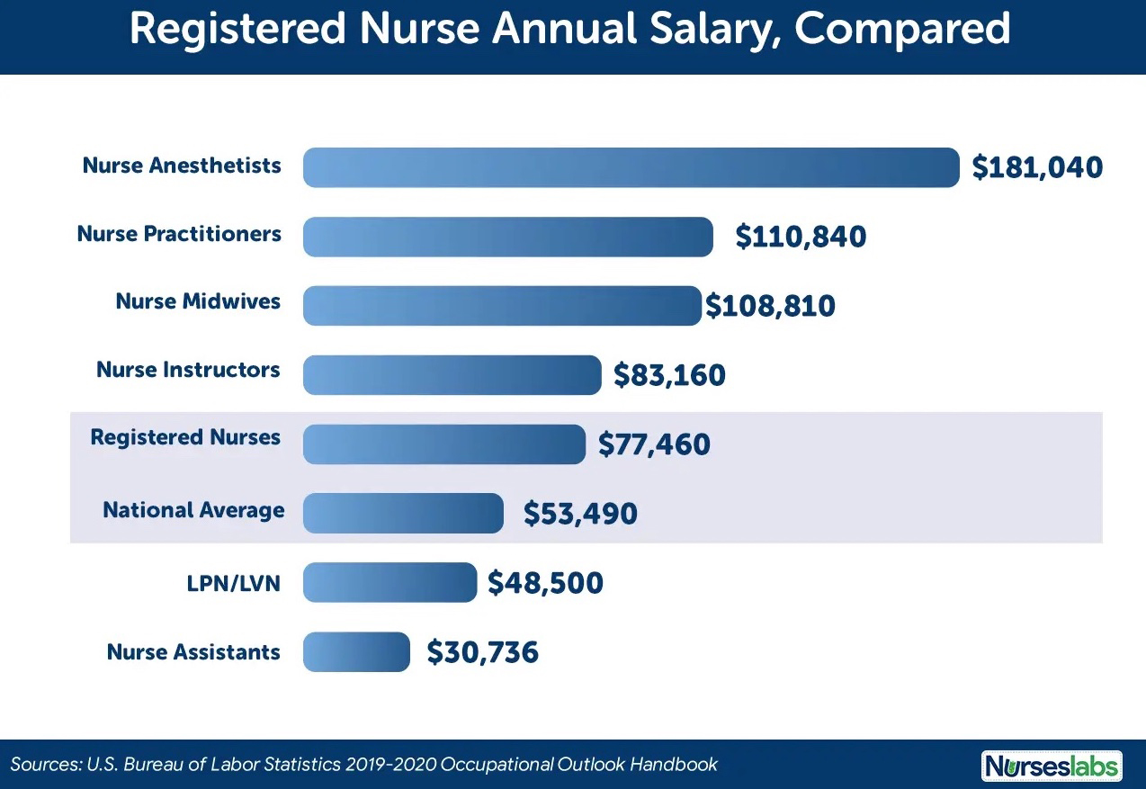
NURSES AVERAGE SALARY

Slide 20








RN SIGN-ON BONUS

Slide 21
COST COMPARISON
TEMPORARY STAFFING HOURLY RATES - $75 -$100/HOUR
ANNUAL COST PER NURSE - $156,000 - $208,000 ( FTE)
OVER 3 YEAR PERIOD PER RN - $468,000 - $624,000 (FTE)
INR - $30 - $35 per hour
Annual Salary: $62,400 - $72,800
Over 3 Years Period - $187,200 - $218,400
HCO ESTIMATED SAVINGS: using INR $280,000 - $406,000

Slide 22
INR EMPLOYER COST
INITIAL RETAINER - $5,000 per Nurse ( per successful candidate employment offered )
ARRIVAL EXPENSES - $5,000 (Airfare, Transportation, Food, Housing, Pocket Allowance)
AGENCY RECRUITMENT FEE - $40,000 Due upon arrival and upon receipt)
3 YEAR CONTRACT Total Cost- $50,000 per Nurse

Slide 23
3 WAYS TO SPONSOR A NURSE
DIRECT HIRE
STAFFING AGENCY
PLACEMENT AGENCY
NOTE: STAFFING AGENCY AND PLACEMENT AGENCY CAN BE THE SAME ENTITY

Slide 24
DIRECT HIRE
Hospitals or Facilities directly hires the nurse with contracts signed directly between nurse and hospital or facility
The hospital HR Representative of DON travel outside US to interview the nurses
Handles all the hiring, immigration, testing and the arrival of nurses
Can be overwhelming if the hospital does not have a dedicated team to handle this process
Hospital or Facility determines what expenses will be handled and wages

Slide 25
STAFFING AGENCY
Staffing Agency hires the nurse for Temporary Staffing use
Nurse is not employed by the hospital or facility but by the Staffing Agency
Nurse is contracted by the Staffing Agency or a contractual or assignment basis – called "Traveling Nurse"
Orientation, benefits and wages are determined by the Staffing Agency
Drawback: Hospital and Facilities – want nurses with experience and ready to work
Agency Rates are usually higher pay but because of the paid expenses, salaries are kept low.

Slide 26
PLACEMENT
AGENCY
Agency acts as a Middleman for the Nurse and the Hospital or Facility
Free the Employer from the burden of the complexities of foreign recruitment
Agency negotiates for the Nurse wages, benefits and recruitment expenses, arrival provisions
Wages are the prevailing salaries offered
Employing Hospital or Facility provides orientation and training

Slide 27
IMPORTANT RESOURCES
https://www.uworld.com/nclex/ -NCLEX REVIEW
https://www.ncsbn.org/index.htm - NCLEX APPLICATION
https://home.pearsonvue.com/ - TEST SCHEDULING
https://www.cgfns.org/services/certification/visascreen-visa-credentials-assessment/ - VISA SCREEN CERTIFICATE
https://ipassprocessing.com/ - CREDENTIALING ASSISTANCE
https://www.ielts.org/en-us/for-test-takers/ielts-online - ENGLISH TEST

Slide 28

THANK YOU!

